Slide 1
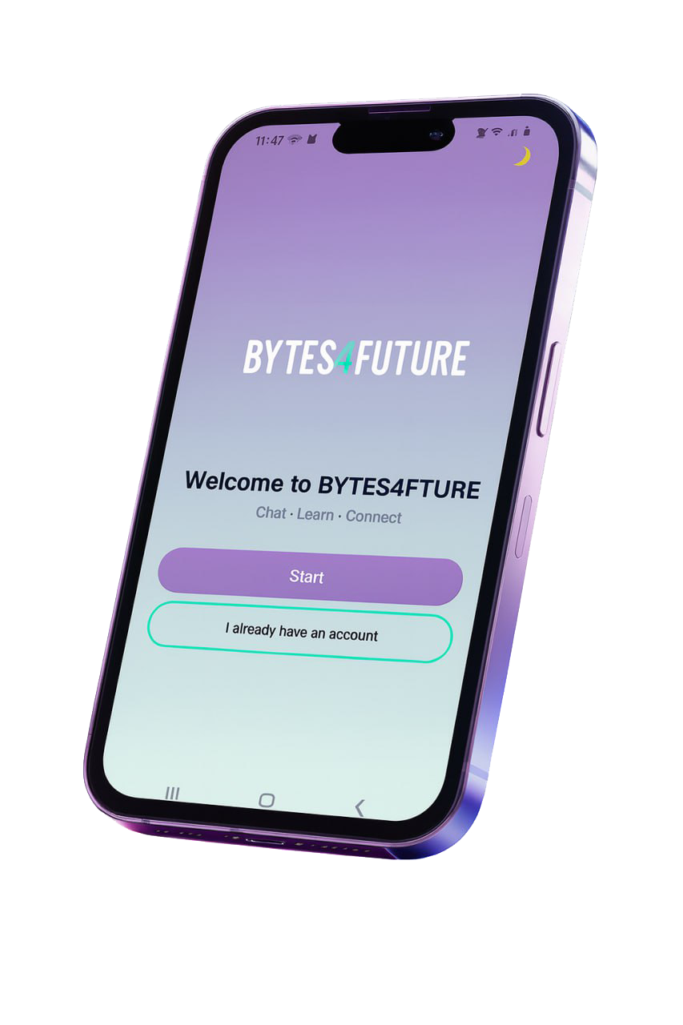

Bytes4Future
Real-Time Chat System
A centralized communication platform designed for seamless collaboration.

Slide 2
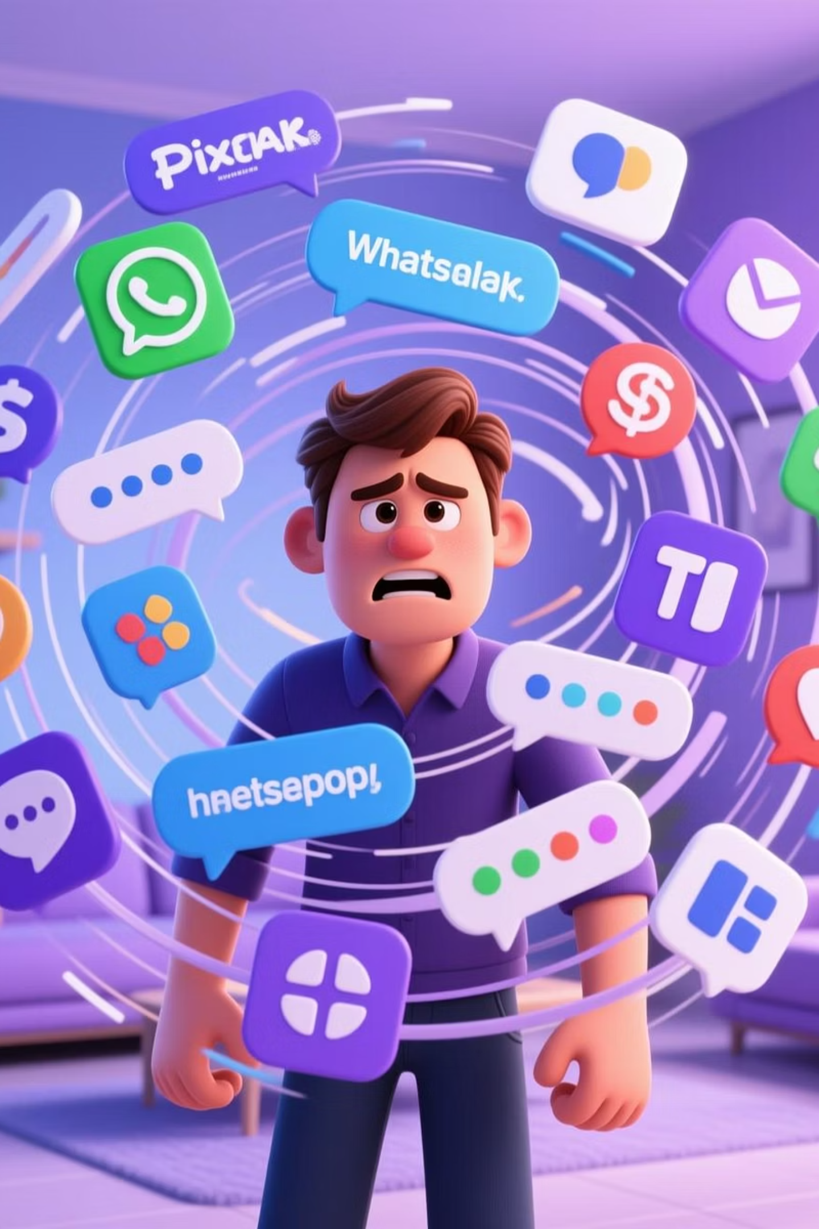
Problem Statement
The Bytes for Future program lacks a simple, unified chat platform for direct communication between trainees and trainers. This causes:
Scattered messages across WhatsApp and E-mail
Delayed support for coding and setup issues
Distraction messages and Notifications on WhatsApp

Slide 3
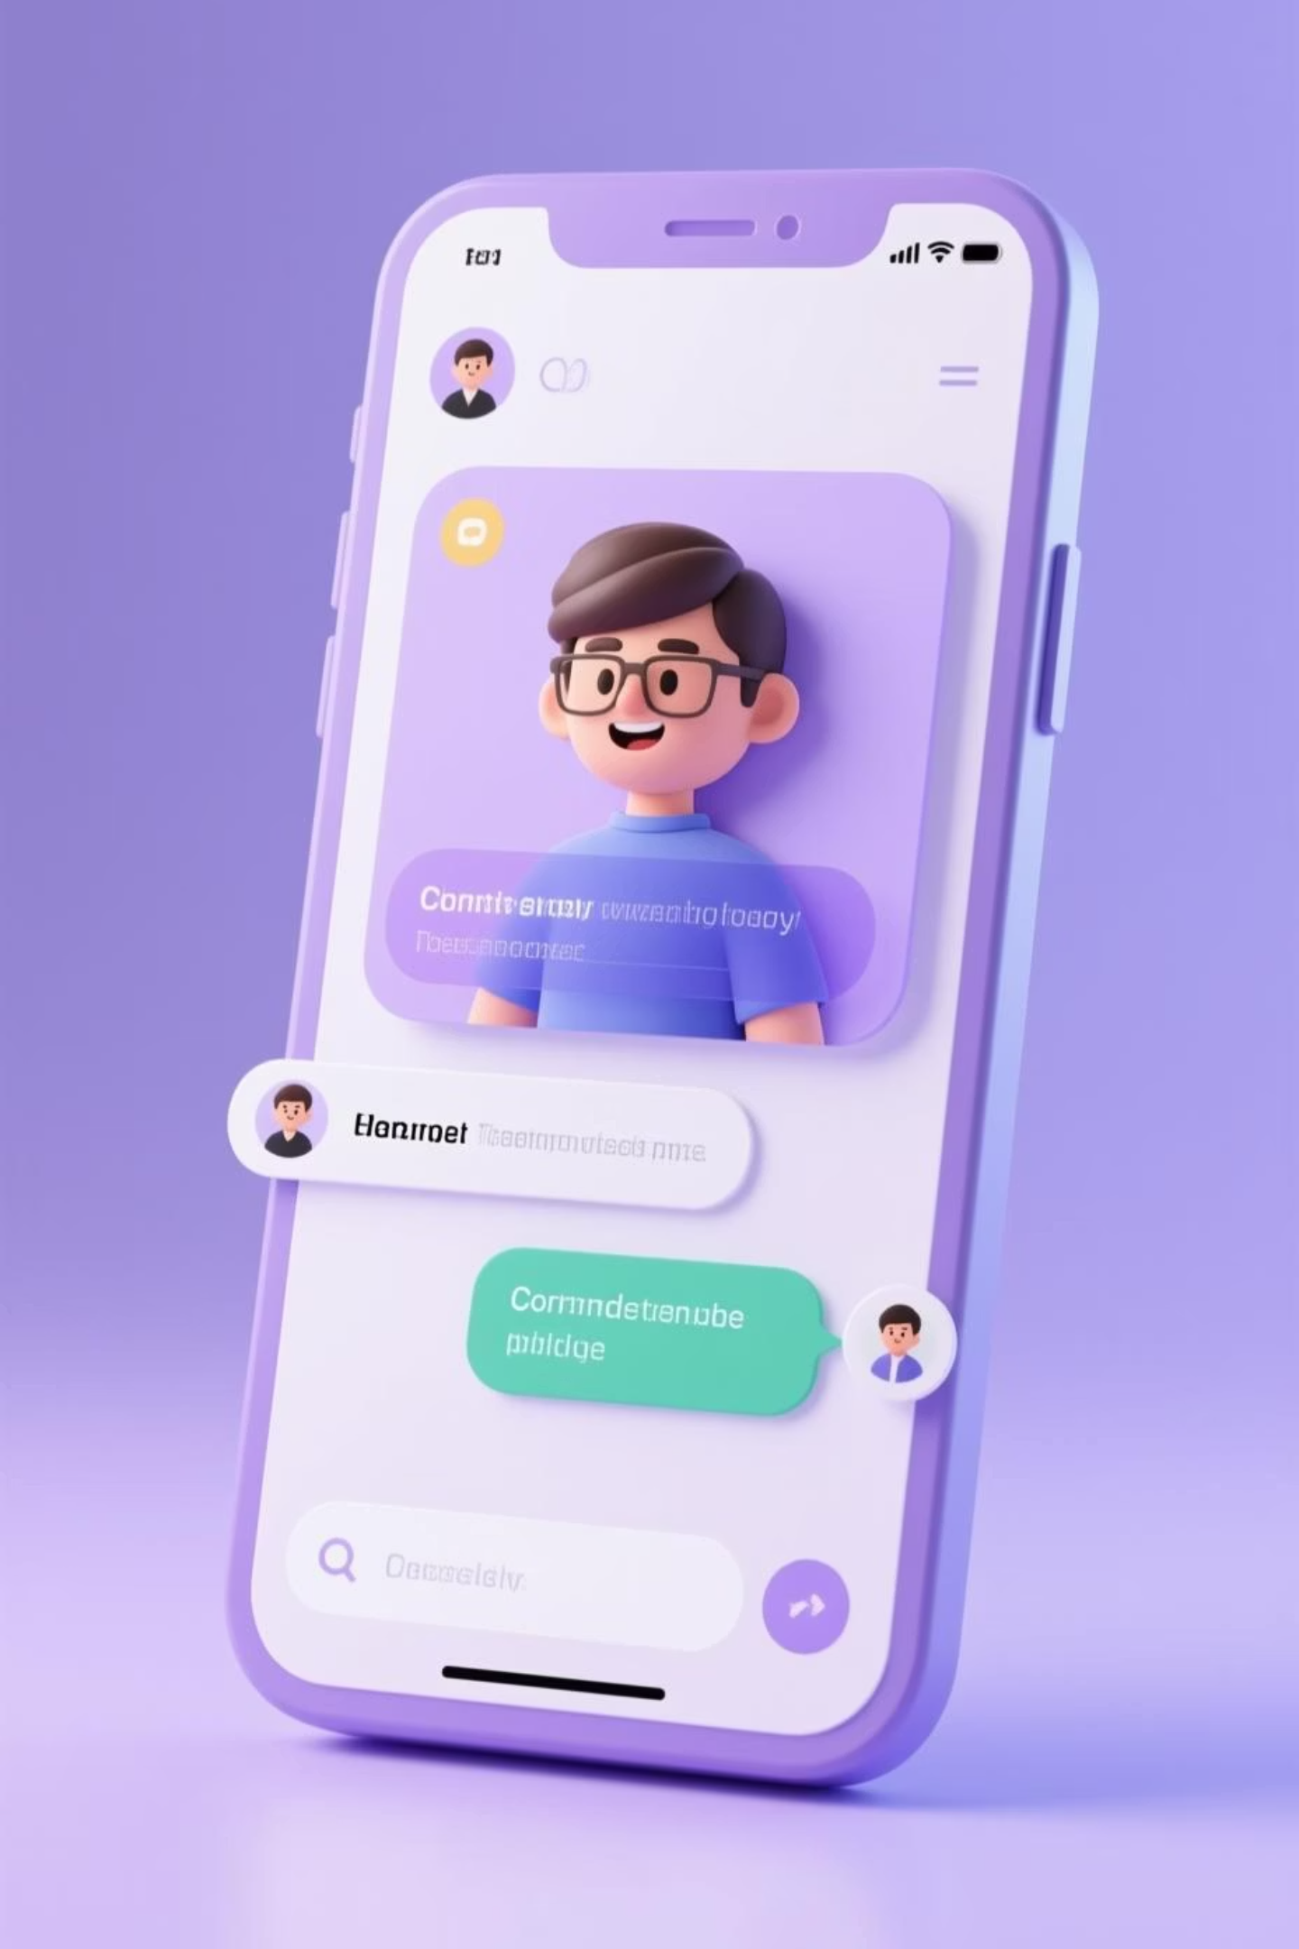
Proposed Solution
We present the real-time chat system — a centralized platform specifically designed for the "Bytes for the Future" program.
Instant Communication
Secure and Professional
Instant messaging similar to WhatsApp, but within the program's environment.
A protected environment with organized and traceable conversations.
Purpose-Built
Specifically designed to meet the needs and workflow of the training program.

Slide 4
Project Objectives
1
2
Instant Support
Unified Hub
Provide immediate connection and timely assistance to all trainees.
Consolidate all interactions between trainees and trainers into one secure platform.
3
4
Organized Communication
Enhanced Collaboration
Enable structured one-on-one and group conversations.
Improve teamwork and knowledge sharing among trainees.
5
6
Privacy
Quick Information Access
Protecting user data and their privacy.
Enable instant search and retrieval of key discussions and shared documents within the platform.

Slide 5
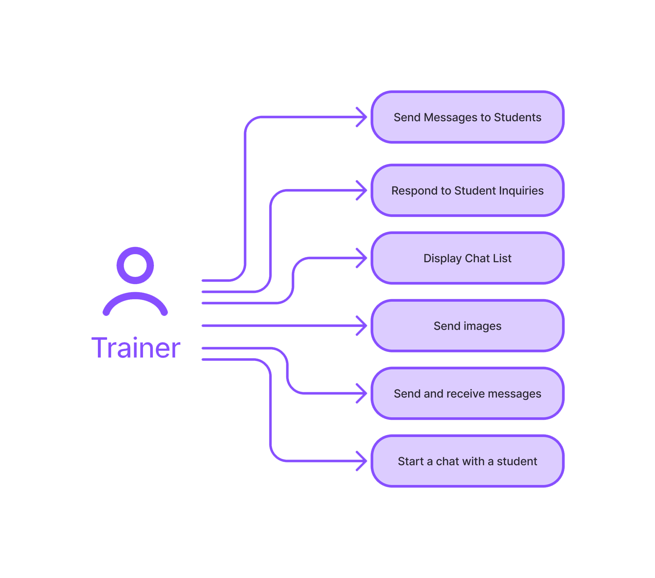
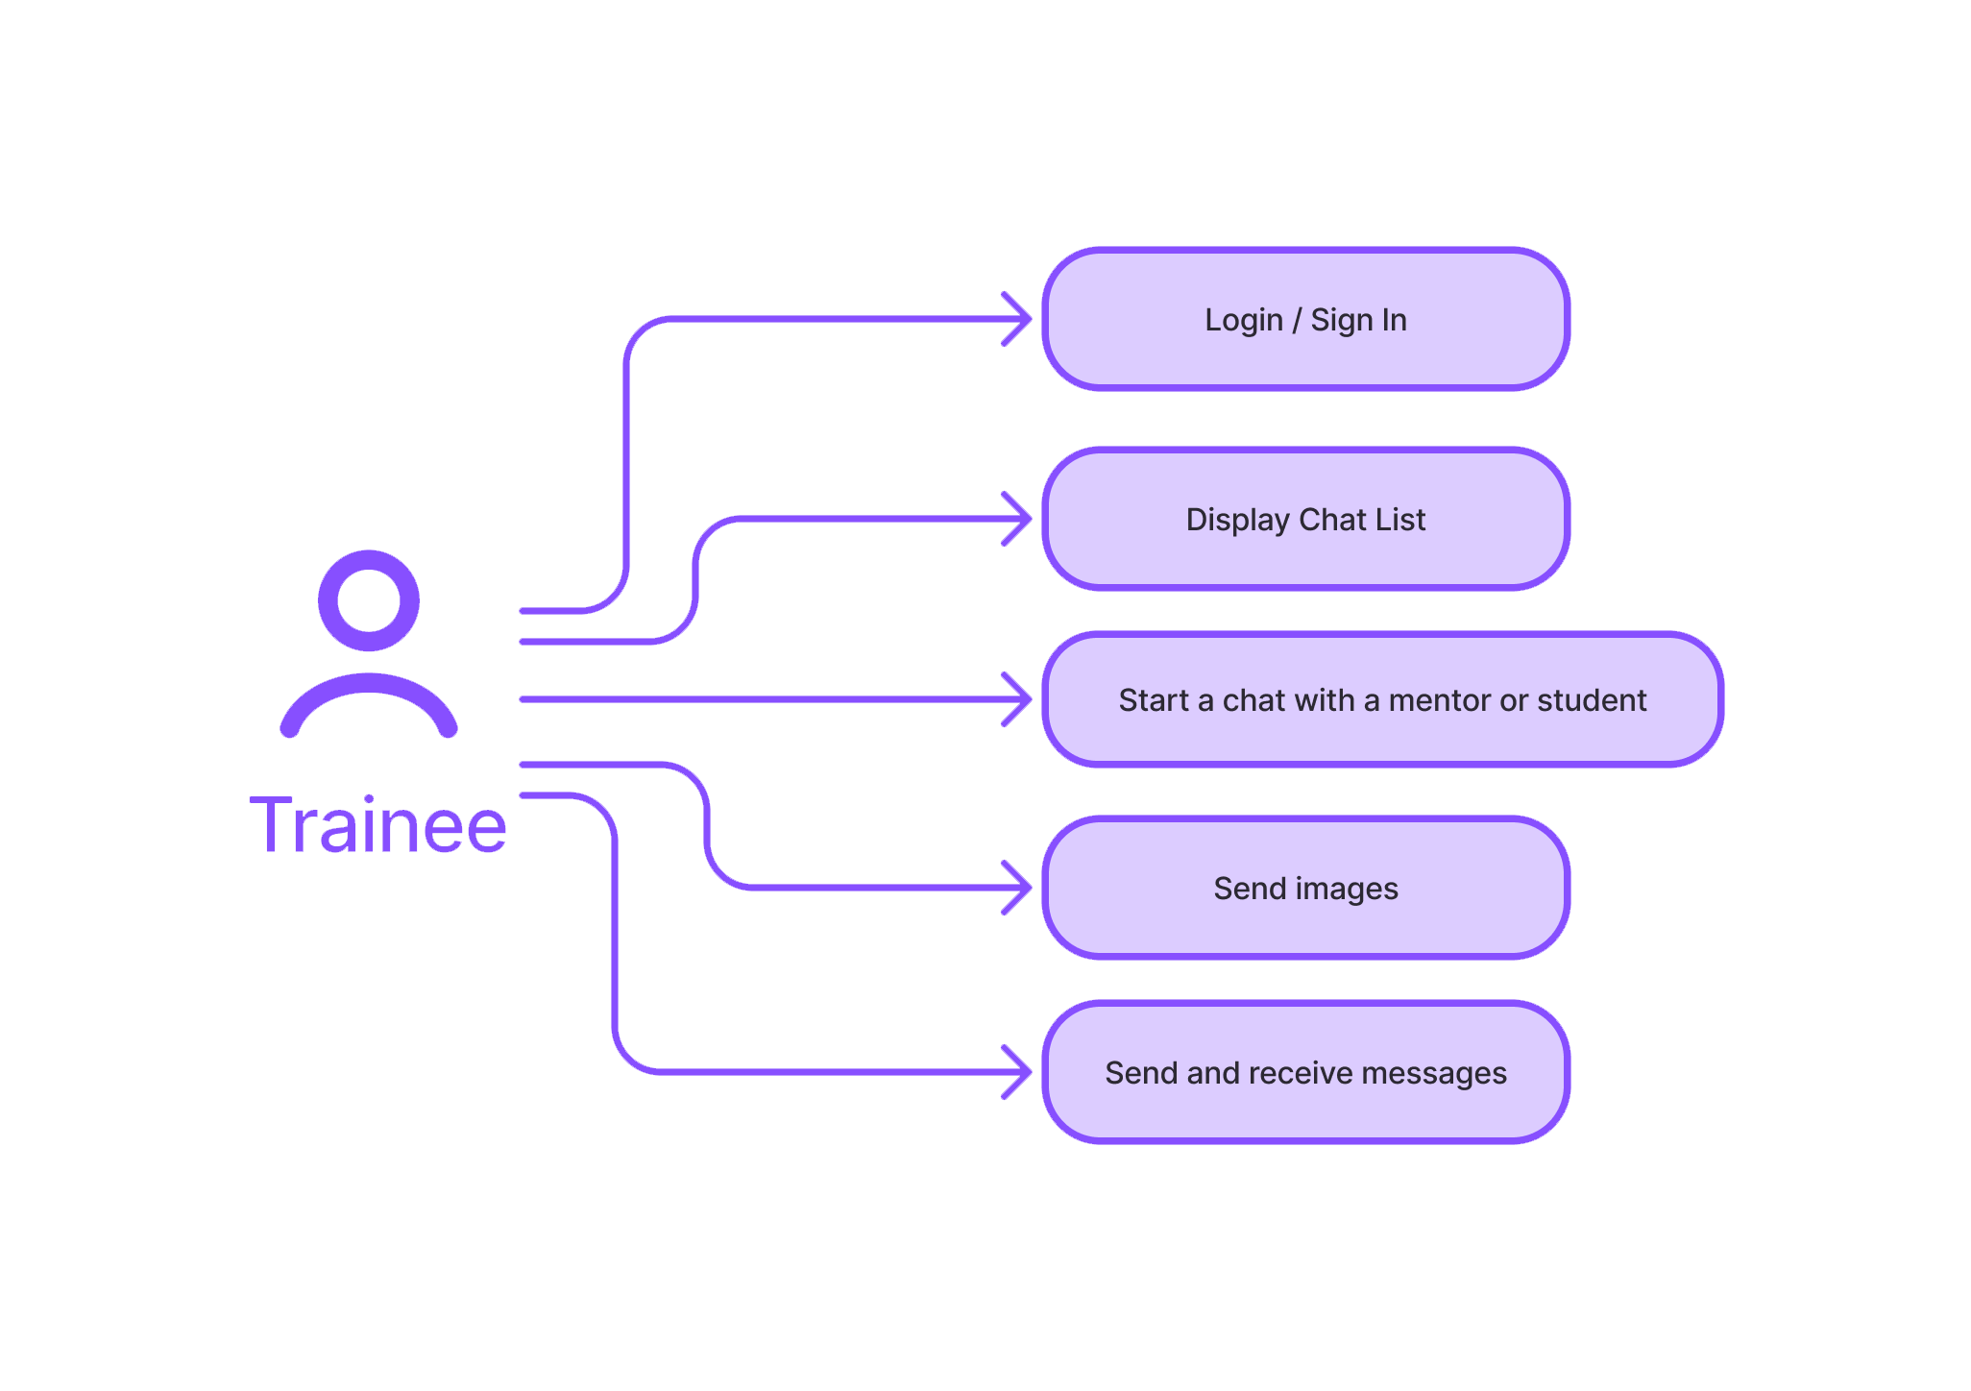
Use Case Diagram
Key actors and their interactions within the real-time chat system:

Slide 6
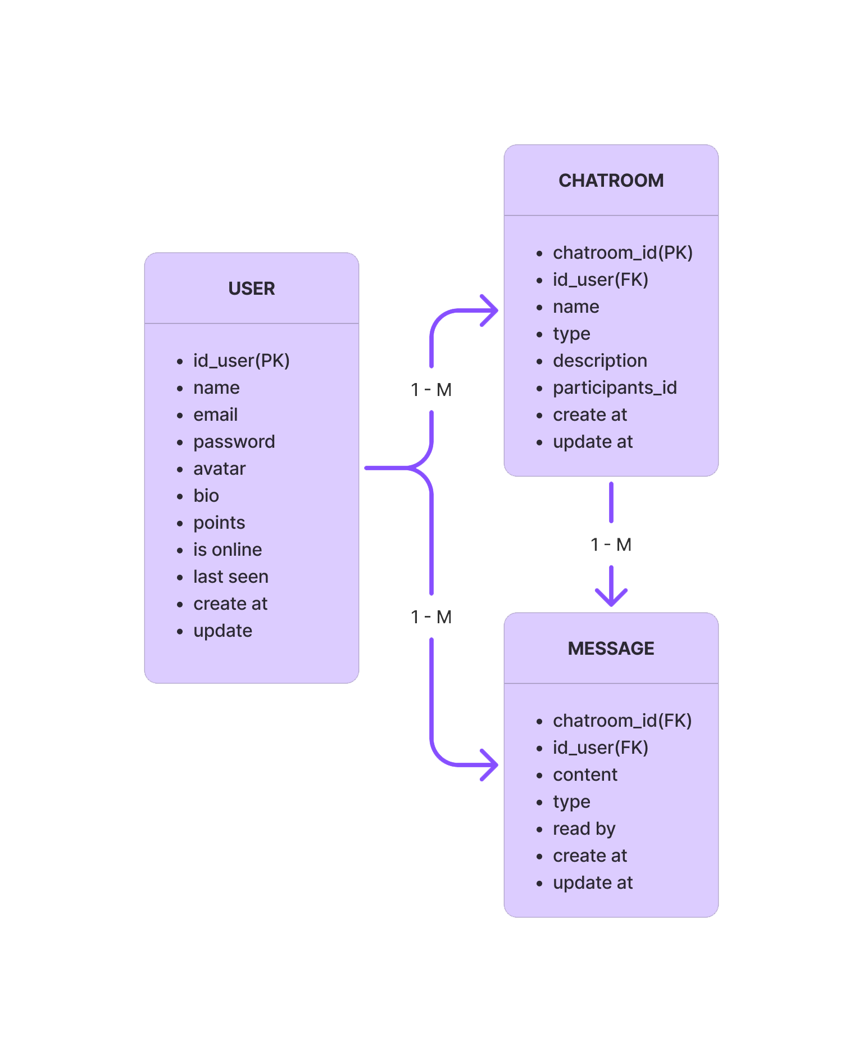
Entity-Relationship Diagram (ERD)
Database structure illustrating the relationships between core entities:

Slide 7



Key Application Services
Authentication Service
Instant Messaging
Chat Service
Secure login, role management, and access control.
Real-time communication via WebSocket.
Management of individual and group conversations.
Share Project and Experience
Video Call
Images Sharing
Exchange of project details and lessons learned.
Real-time live audio and video communication.
Rapid exchange of digital images within conversations.

Slide 8
Functional Requirements
Key features that support the real-time chat system:
01
02
03
Authentication
Instant Messaging
User Dashboard
Secure user login with role-based access control.
Send and receive instant messages via WebSocket.
User can add and edit information's
04
Automated Group Membership
Users are automatically assigned to default chat groups upon registration.

Slide 9
Development Timeline
Planning Setup
Backend Development
Frontend Development
Testing, Integration & Launch
Designing
Our phased approach ensures efficient delivery and strict quality control for the real-time chat system within a total time of 4 days.

Slide 10
Future Enhancements and Recommendations
Expand the chat system's capabilities with these advanced features, ensuring continuous innovation and user satisfaction post-initial launch.
Notifications
Advanced Analytics
LMS Integration
Automated Moderation
User Behavior Analytics
Next Steps
Review and Feedback
Notification
Implementation Roadmap
Archive Chats
Pilot Program Planning
User Training

Slide 11

Thank You
We look forward to building this solution together.
Project Team
Yahia Dada
Dima Dabous
Rita Wartan
Amjad Al-arangi

